Slide 1
Overview
Human trafficking
The exercise of coercive control over persons for the purpose of exploitation
Second largest – and fastest growing – criminal industry in the world
Under 18 + Commercial Sex Act = VICTIM
“One of the great human rights causes of our time.” - President Barak Obama, 2012

Slide 2
Human Trafficking is modern-day slavery
Who are the victims?
Victims are forced to provide labor or commercial sex and can be:
US citizens or foreign nationals Men, women or children
Where does human trafficking happen?
Human trafficking can happen in many situations, including in:
Commercial sex industry (street prostitution, strip clubs, fake massage business, escort services, brothels, internet) Factories (industrial, garment, meat-packing) Farms, landscaping, or construction Peddling rings, begging rings, or magazine crews Private homes (housekeepers, nannies, or servile marriages) Restaurants, bars, and other service industries (nail or hair salons)
Notes:
A fake massage business is an example of a “commercial Front”

Slide 3
Global Slavery Index - 2017
Right now 40.3 million people are in modern slavery.
Since 2012 89 million different people have been enslaved for some period.
Some form of slavery exists in 167 countries. (2016)
These people cannot refuse or leave because of threats, violence, coercion, deceptions and / or abuse of power.
Source: Global Slavery Index / ILO
Notes:
https://www.globalslaveryindex.org/

Slide 4
World Wide – Stats
 | Private Labor | Sex Exploitation | Forced Marriage
Estimated victims (millions) | 16.0 9.4 female | 4.8 4.75 female | 15.4 12.9 female
Average duration | 20.5 months | 23.4 months | life
Notes | Estimated $150b annual profit | 1 million children | 5.7m under 18 at marriage 2.5m under 15 at marriage
Source: International Labour Organization report, 2017

Slide 5
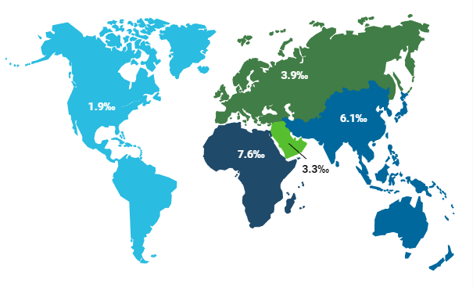
Global Slavery Index - 2017
Thousandths of the population in modern slavery
Notes:
https://www.globalslaveryindex.org/

Slide 6
How much does someone cost?
Who? | US $ | Who? | US $ | Who? | US $
Babies in Indonesia | 250 | Babies in China | 7,800 | Roma child bride | 270,000
Girl in Madagascar | 3 | Bride in China | 11,800 | Virgin teen girl Iraq | 5,000
Girl in India | 24 | Boy in India | 45 | Teen girl in Iraq | 2,500
Child in Ghana | 300 | Child in U.K. | 25,000 | Teen girl in Canada | 6,000
Child in Mail | 600 | Girl in Bangladesh | 250 | Girl in Romania | 6,000
Virgin girl Columbia | 2,600 | Girl in Kenya | 600 | Woman in N Korea | 1,000
Virgin child Cambodia | 800
Source: Havocscope Global Black Market Information
Notes:
Source: http://www.havocscope.com/black-market-prices/human-trafficking-prices/
More information: http://www.havocscope.com/fact-book-on-human-trafficking/

Slide 7
Think it Doesn’t Happen in America?
Source: Polaris Project
Notes:
Source: https://polarisproject.org
The map is the Polaris Project “Heat Map” showing the density of call to the National Hotline

Slide 8
United States Statistics
2.1 million: people are trafficked in America.
100,000 – 300,000: American children at risk for trafficking per year
45% of sexually exploited NYC youth were exploited in hotels.
25%: of child sex tourists are North American.
Source: ECPAT-USA

Slide 9
US Victims of Sex Trafficking
94% | 75% | 88% | 41%
Female | U.S. Citizens | Minorities | Minors
Notes:
African American male children have nearly the same risk of as female counterparts

Slide 10
Think it doesn’t happen on Long Island?
Source: LIAT Research
Notes:
Source: LIAT
The map is the result of LIAT’s research on media reports of incidents of Human Trafficking on Long Island this decade (since 2010)

Slide 11
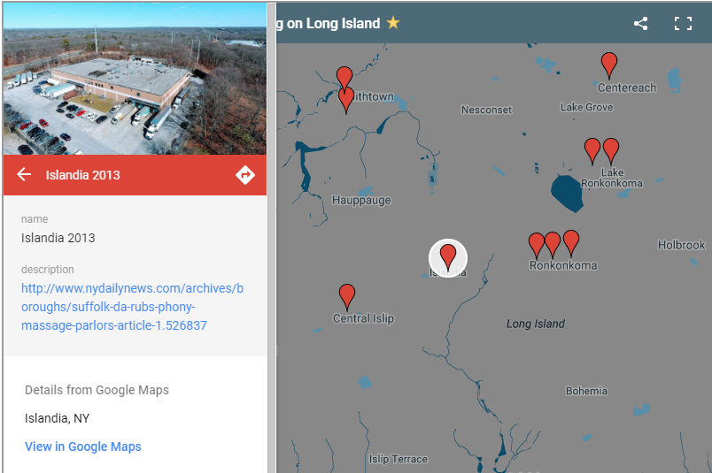
Examples of Trafficking on Long Island
In Islandia, Patchogue, Medford, Islip and Lindenhurst sex shops masquerading as massage parlors. Typically and in this case the workers are arrested. However, in this case, the trafficker, or “madam” was also arrested.

Slide 12
Examples of Trafficking on Long Island
http://newyork.cbslocal.com/2014/02/06/long-island-group-home-workers- allegedly-forced-developmentally-disabled-people-to-fight/
Notes:
At 10 -15 times a day, 6 days a week. The math is these girls are raped 3,000 – 4,500 times a year. 15,000 – 22,500 times before they turn 18 if they are not rescued.

Slide 13
Who Would Traffic a Child?
Notes:
Source: Covenant House study of survivors of DMST
Common Misconception: Kids are trafficked by Strangers

Slide 14
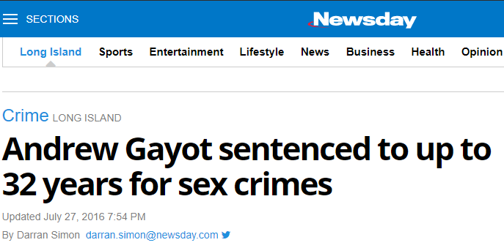
Example of DMST on Long Island
Sources: WPIX, Newsday
Notes:
More details came out during testimony. He hit his victims with a hammer, threatened them with a chain-saw

Slide 15
Warning Signs of a Victim
Homelessness
Chronic Runaway
Previous Sexual Abuse
Travels with older man
Older, dominating boyfriend
Multiple, repeated Sexually Transmitted Diseases
Tattoos or brands
Signs of violence, bruises, burns, etc.
Truancy, breaking curfew

Slide 16
Warning Signs of a Trafficker
Easily Jealous
Controlling & Violent
Promises are too good to be true
Always knows ways to make a lot of money
Flashes money
Vague about job
Projects financial responsibility
Encourages sexual photos & dancing (for money)
Demanding about sex

Slide 17
What to Ask if You Suspect DMST
Have you ever left home without your parents or guardian knowing? How often?
How do you take care of yourself when you are away from home?
Do you have a boyfriend? How old? What do you enjoy doing together?
If there is a visible tattoo, ask about it:
When did you get it?
What does it mean?
Where did you get it?
How often do you see your school friends? What do you enjoy doing with them?

Slide 18
What to DO if You Suspect DMST
National Human Trafficking Resource Center (NHTRC)
1-888-373-7888
Text HELP or INFO to BeFree (233733)
E-mail: NHTRC@PolarisProject.org
Confidential | Toll-Free | Interpreters available

Slide 19
Who is L.I.A.T.?
Long Island Against Trafficking seeks to educate communities, work with legislators, and raise money to help victims of human trafficking live fully restored lives.

Slide 20
The Trafficking Pipeline
Trafficking Victims
At Risk Populations
Survivors
L.I.A.T. works at all stages of the trafficking pipeline
Protecting At Risk populations
Equipping Law enforcement to prosecute traffickers
Helping rescued and escaped victims become survivors

Slide 21
The Challenges
Competing Law Enforcement Priorities
Opiate crisis
MS-13
DWI
Customers
40 Million regular users of Porn in US
1 in 7 men in US have used a prostitute
Myths
Belief that trafficking victims enjoy the sex
Belief that trafficking victims are willing participants
Special needs for survivors
Foster system ill-equipped to provide proper counseling
Survivors not educated on the help available to them
Not enough facilities (beds) to care for survivors

Slide 22
How L.I.A.T. Helps
Education | Grants | Lobbying
Public Service Announcements Public Speaking Engagements Hotel Training | Survivor Care Protecting At-risk Youth | Research Supporting Legislation

Slide 23
How Can I Help?
Education | Grants | Lobbying
Talk to your circle about what you learned Bring us to speak to your group Volunteer to do Research | Apply for a grant We look to help groups that are assisting survivors and helping at-risk populations Give financially Host a fundraiser With no paid staff our primary expense is funding grants | Join our email list: send an email to info@endlitraffick.org Write your legislators We notify our mailing list when there is pending legislation.

Slide 24
How can I help?
Volunteer
Meetings each month 3rd Saturday each month in Medford. RSVP to info@endlitraffick.org Projects - Use your skills and talents Hotel Initiative Public Service Announcements Assisting shelters Collectively we each bring something different

Slide 25
Compiled by Long Island Against Trafficking
Web: www.endlitraffick.org
Email: info@endlitraffick.org
Phone: 631-447-6287
Facebook: Long Island Against Trafficking
Twitter: @EndLITraffick
Address: 445 Furrows Road, #18.
Holbrook, NY 11771
Meetings monthly in Medford
Notes:
25

Slide 26
Current Human Trafficking Statistics
Traffickers often have personal relationships with victims
2013 Covenant House/ Fordham University study concluded
Relationships between trafficker and victim:
36 % Parents or family members
27 % “Boyfriend”, significant other
14 % Employer
14 % Friend of family
9 % Strangers

Slide 27
Healthcare Response to Human Trafficking
A Healthcare facility, Mental health facility and or various service providers may be the only place a potential victim may frequent outside of his/her trafficked environment.

Slide 28
Why Awareness is Important
2014 study conducted by CAST
64% of survivors accessed healthcare while in trafficking situation
96% indicated they had never been provided with information about trafficking
81% indicated they had never been screened for trafficking
2014 study conducted by Loyola University Chicago
88% of survivors accessed healthcare while in trafficking situation
68.3% of these survivors went to a hospital or ER
Notes:
Coalition to abolish slavery and trafficking

Slide 29
Why Awareness is Important
2014 study published in the Annals of Health Law
106 domestic sex trafficking victims and survivors
88 % had reported contact with a health care provider
2017 study reported by SOAR to Health and Wellness/ US Dept of Health and Human services
117 patients surveyed
55 % visited an ER, 44% visited Primary Care, 26 % visited OB/GYN and 26% visited a Dentist

Slide 30
Ongoing Advocacy
Research your community resources
Discuss protocols/procedures with supervisor/managers
Become a member of a community/employee task force
Volunteer with a local organization
Questions?

